Slide 1
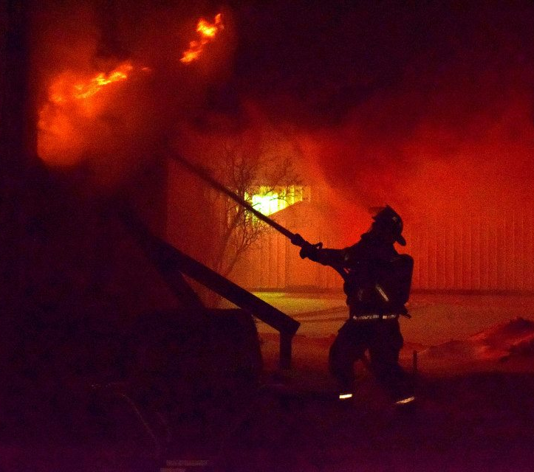

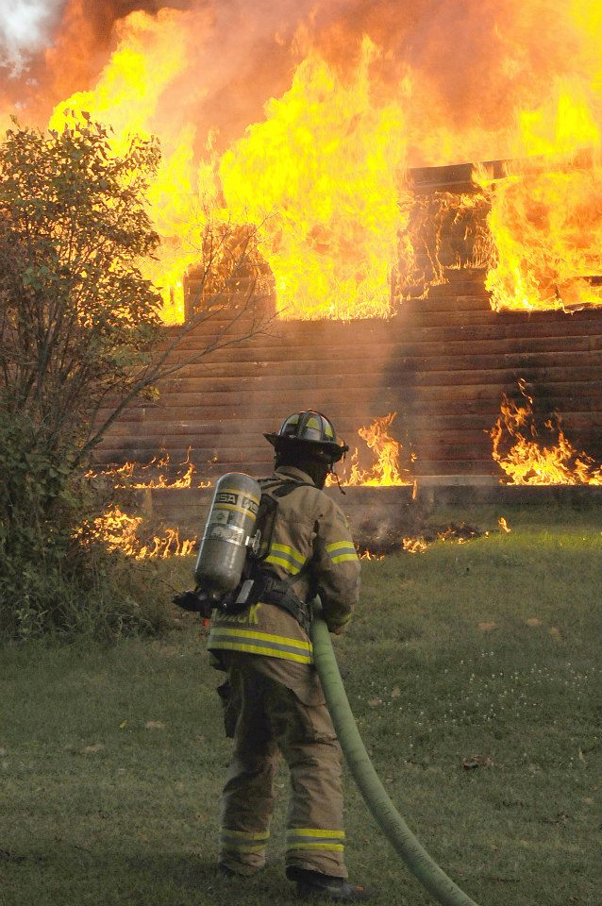
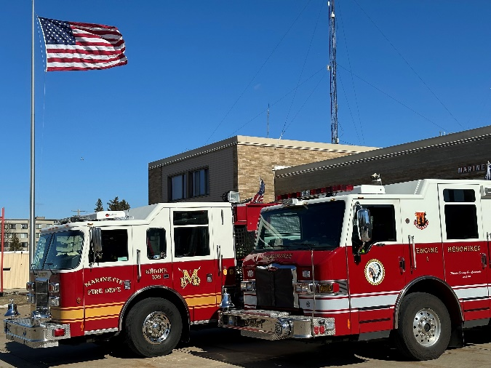


Interested in a career in FIREFIGHTING?
Marinette Fire Department
1450 Main Street
Marinette, WI 54143
715-732-5178
www.marinette.wi.us
Menominee Fire Department
2509 10th Street
Menominee, MI 49858
906-863-5511
www.menominee.us
2026 Marinette & Menominee Fire Camp

Slide 2
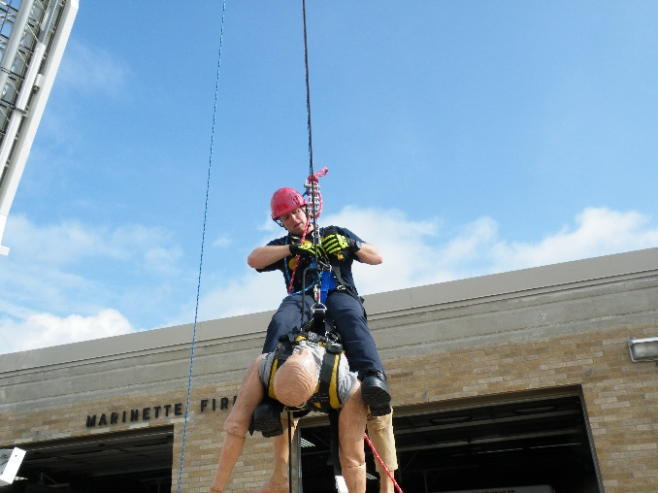
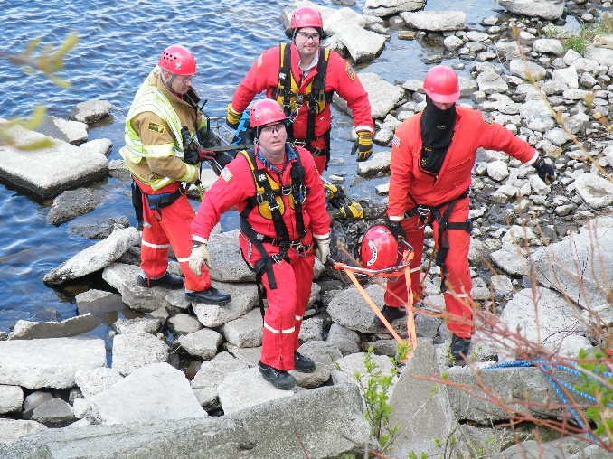
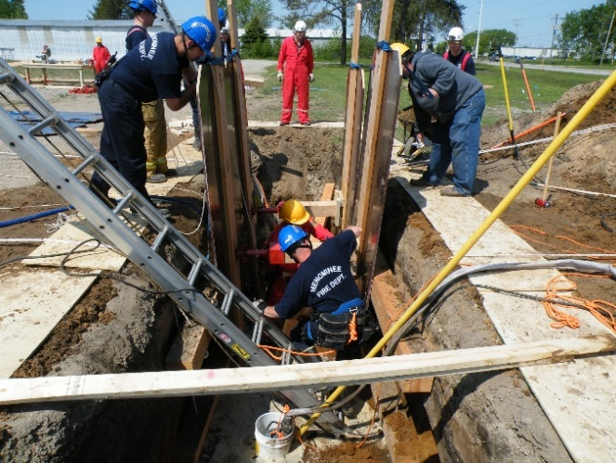
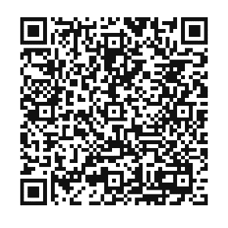
2026 Marinette & Menominee Fire Camp
“Hard times don’t create heroes. It is during the hard times when the ‘hero’ within us is revealed.”
- Bob Riley
Wednesday, July 22nd
AND
Thursday, July 23rd
8:00 AM – 12:00 PM
Marinette & Menominee Fire Department
Day 2 – EMS & Physical Agility Course
(Menominee Fire Station)
Station Tour
Emergency Medical Services (EMS)
Basic First Aid
CPR
Physical Agility Course
Ladder Rides
Grill out
Day 1 – Fire
(Marinette Fire Station)
Career Outlook
Daily Firefighter Activities
Station Tour
Personal Protective Equipment (PPE)
Self-Contained Breathing Apparatus (SCBA)
Firefighting Tools & Equipment
Fire Ground Operations
Auto extrication
Eligible Students must be:
Interested in a career in firefighting
Incoming High School Junior or Senior
Enrolled in School Districts in Marinette & Menominee Counties
Scan QR Code to Apply:
Applications MUST be submitted by June 5, 2026

